Slide 1
Mobile Musical Moments
Project Manager: Scott Thompson
Development Team: Joshua Brungar, Quentin Griffiths, Stephen Nancekivell, Simon Wadsworth

Slide 2


Slide 3
The Vision
To provide a software package that will allow a customer to record a currently playing song, and have it return the name and artist of the song.

Slide 4
Licensing
Our software package uses some closed source code – Entropy Fingerprinting Algortihm

Slide 5
Audio Recording
No premade features in the .NET Compact Framework for dealing with WAV files
To overcome this our own classes needed to be written
[How the recording works]

Slide 6
Interface
Buttons and Controls
Splash Screen
Outflow Layout

Slide 7
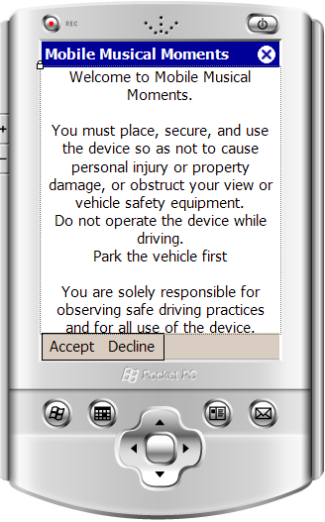
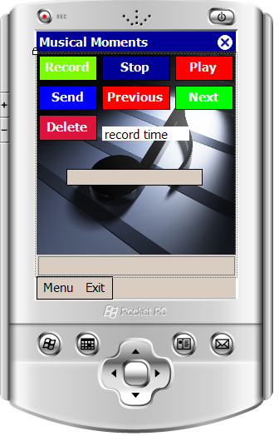
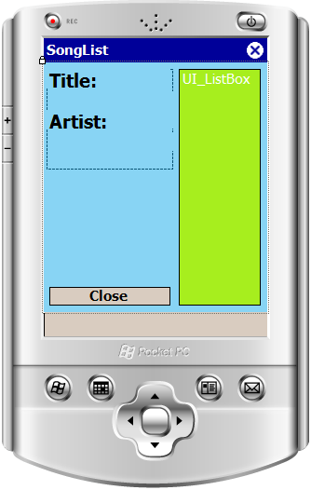
Interface

Slide 8
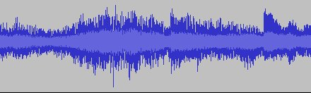
How we fingerprint audio.
More more less more less

Slide 9
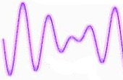


Fingerprint Robustness.

Slide 10
The Backend
The backend essentially consists of a server that accepts simple queries from the device and returns an answer
It’s written as a threaded C# TCP Network application
It’s all string based

Slide 11
The Backend Server
CLIENT
SERVER
Challenge

Slide 12
The Backend Server – Concurrency Problem
INCOMING CONNECTION
INCOMING CONNECTION
INCOMING CONNECTION
SERVER
Notes:
Server will only allow one connection at a time

Slide 13
The Backend Server – Concurrency Problem
INCOMING CONNECTION
INCOMING CONNECTION
INCOMING CONNECTION
SERVER
Connection Thread #1
Connection Thread #3
Connection Thread #2
Notes:
Solution: Put each connection into a thread. Each incoming connection will go into its own thread.

Slide 14
The Backend Server
CLIENT
SERVER
Fingerprint
Returned Data
In XML format
Comparison
Song List

Slide 15





Process overview
Song Info

